Slide 1
Computer Graphics: 3D – Projections
Tommy Marrinan, PhD

Slide 2
3D to 2D
Mapping 3D models to a 2D screen
More obvious separation of world-space from view-space
Behavior similar to a camera
Objects exist in physical space (e.g. UST Campus)
Photograph from many different angles
Many different camera settings too
Same model, many different views
Results in many different final images

Slide 3
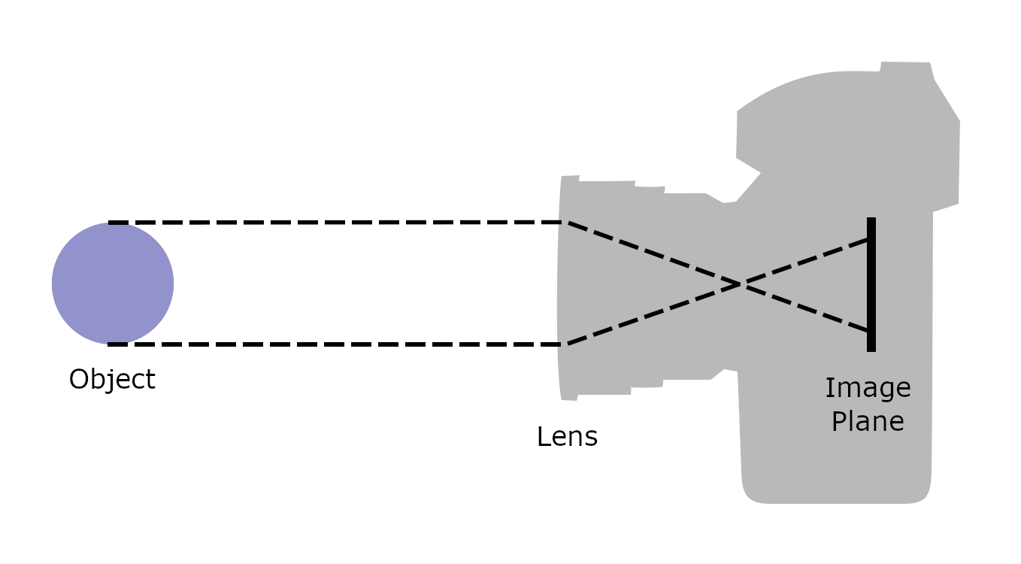
Projections – Camera
Light filtered through lens
Projected onto flat plane (image sensor)
Results in 2D view of 3D world

Slide 4
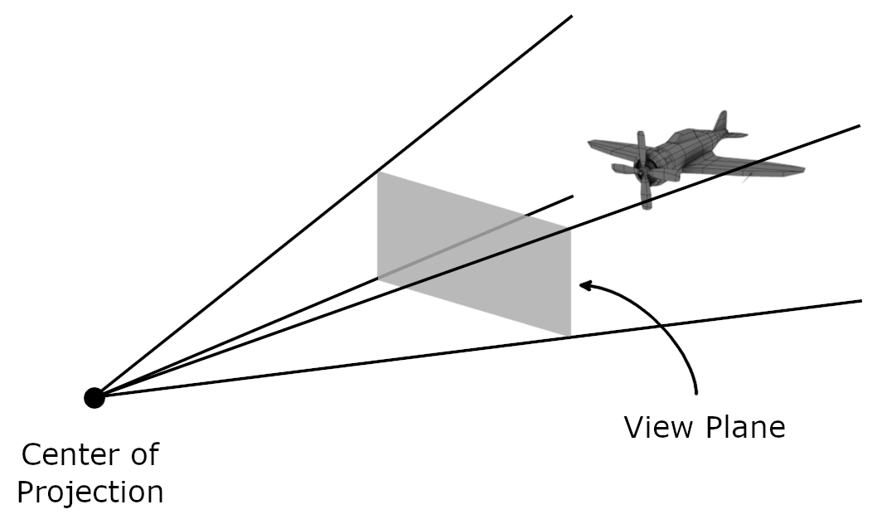
Projections – Computer Graphics
Image formed on a view plane
Rays cast from the center of projection to each vertex in the models, intersecting with the view plane
Use 2D drawing routines
(window)
Notes:
NOTE: view plane can be in front of, behind, or even inside the models

Slide 5
Projections
Parallel
Center of projection at ∞
All projectors will be parallel to one another
Must define direction of projection (DOP)
2 sub-types
Orthographic: DOP is perpendicular to view plane
Oblique: DOP is not perpendicular to view plane

Slide 6
Projections
Perspective
Center of projection a finite distance from view plane
Need to define a point for the center of projection
More visually realistic
Objects farther away appear smaller

Slide 7
Perspective vs. Orthographic
Which one is better?
Depends whether the goal is the mathematically correct depiction of length and angles, or a realistic looking image of the object

Slide 8
Specifying a 3D View
Camera
PRP: projection reference point
Parallel: used to calculate DOP
Perspective: position of camera (equivalent to COP)
SRP: scene reference point
Center of scene (i.e. what the virtual camera is looking at)
VUP: view up vector
Vector that gives reference to which direction is up in the virtual camera’s image plane

Slide 9
Specifying a 3D View
View Volume
Uses VRC: View Reference Coordinate system (u, v, n)
u: right with respect to the virtual camera’s image plane
v: up with respect to the virtual camera’s image plane
n: from the SRP to the PRP
Origin at PRP
Defined by boundaries (left, right, bottom, top, near, far)

Slide 10
Specifying a 3D View
View volume boundaries
Near: distance to the window
Left, Bottom, Right, Top: specify the points (in VRC) on the near plane that are mapped to the lower-left and upper-right corners of the window respectively
Models outside any edge will be clipped

Slide 11
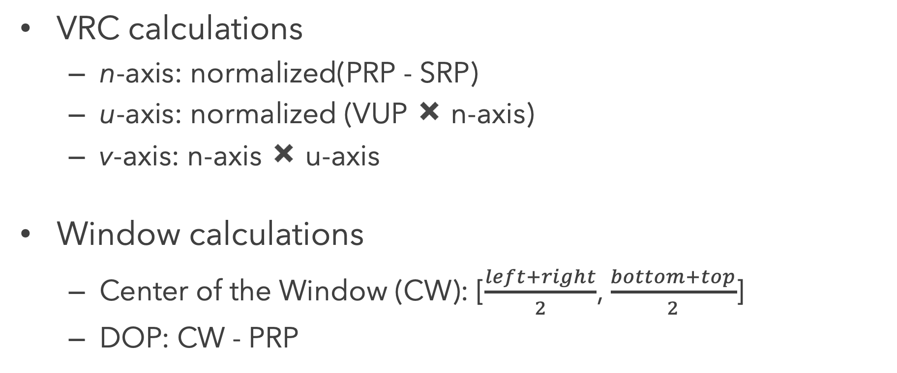
Specifying a 3D View
VRC calculations
n-axis: normalized(PRP - SRP)
u-axis: normalized (VUP ✖️ n-axis)
v-axis: n-axis ✖️ u-axis
Window calculations
Center of the Window (CW): [$\frac{left+right}{2}$, $\frac{bottom+top}{2}$]
DOP: CW - PRP

Slide 12
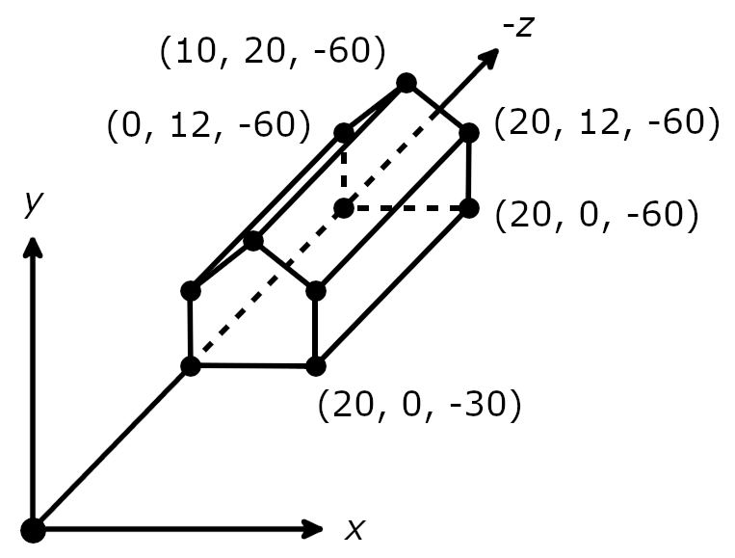
Examples
Model of house
PRP: (10, 9, 0) SRP: (10, 9, -30)
VUP: (0, 1, 0) Near,Far: [30, 100] Left,Right: [-11, 11]
Bottom,Top: [-11, 11]

Slide 13
Examples
Model of house
PRP: (38, 10, -45) SRP: (20, 10, -45)
VUP: (0, 1, 0) Near,Far: [18, 100] Left,Right: [-16, 16]
Bottom,Top: [-15, 17]

Slide 14
Examples
Model of house
PRP: (44, 20, -21) SRP: (20, 20, -45)
VUP: (0, 1, 0) Near,Far: [12, 100] Left,Right: [-15, 5]
Bottom,Top: [-10, 10]

